Slide 1
Chinese Traffic Sign Recognition
Based on Annotated Street View Images
Ke Xu (Sophomore; Data Science)
Yuhan Yao (Sophomore; Data Science)

Slide 2
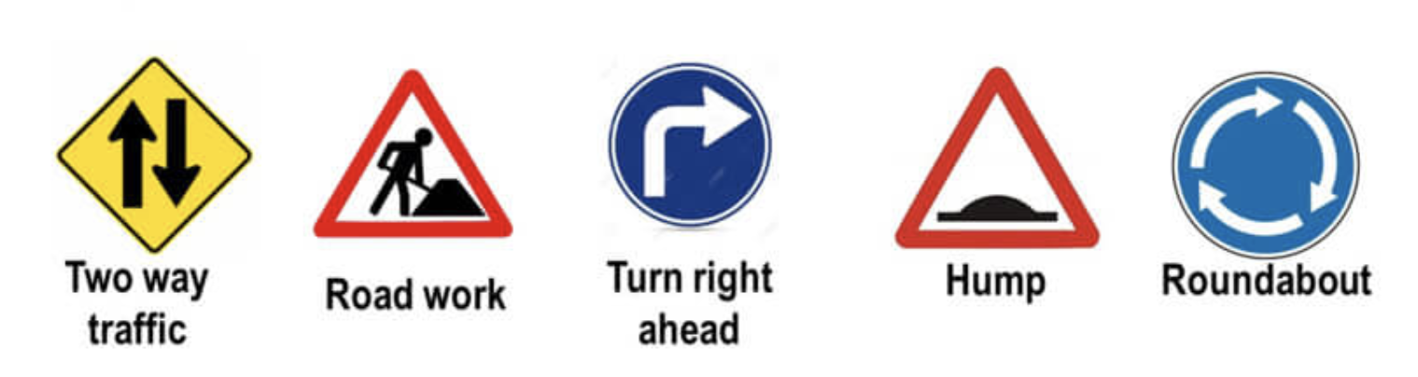
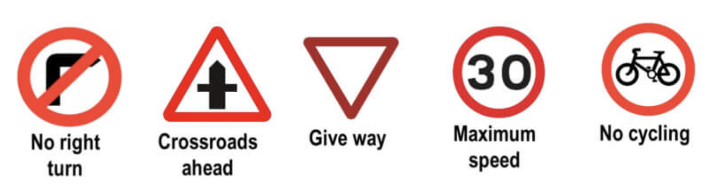
Background & Motivation
“Before self-driving vehicles can truly operate autonomously, they need to master Street Sign 101.”
------- Laura Bliss (CityLab)

Slide 3
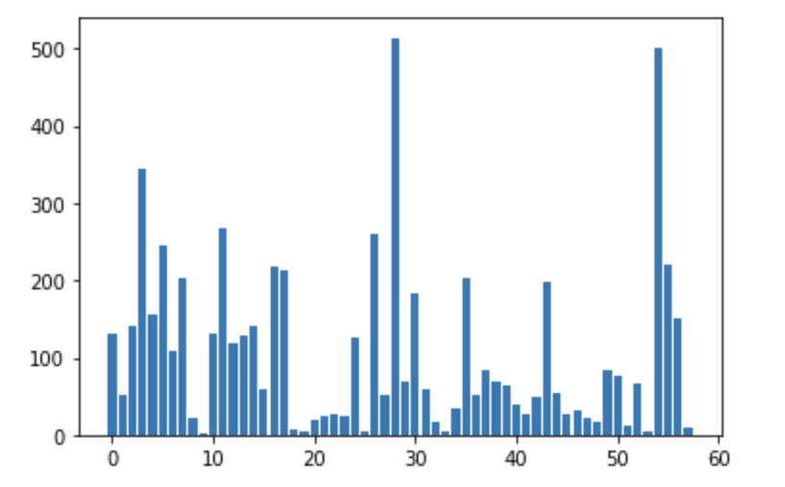
Data Source & Description
Chinese Traffic Sign Database
- Traffic Sign Recognition Database
http://www.nlpr.ia.ac.cn/pal/trafficdata/recognition.html
Imbalanced data
4170
1994

Slide 4
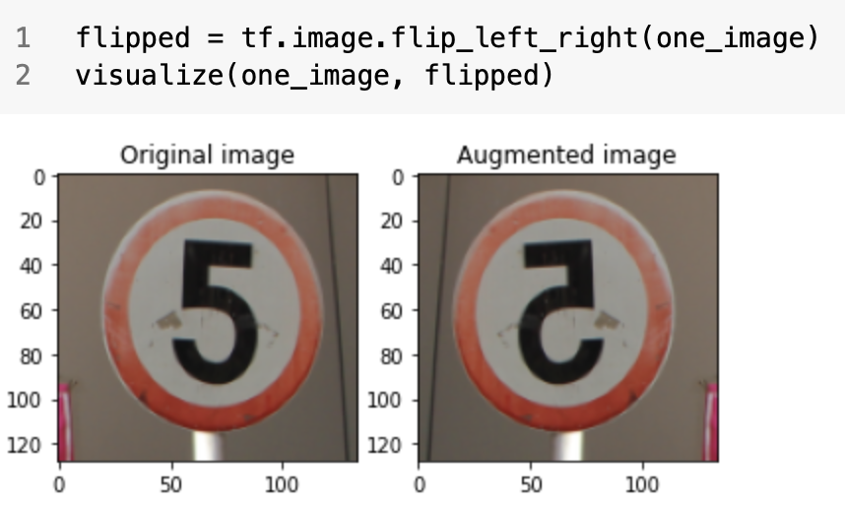
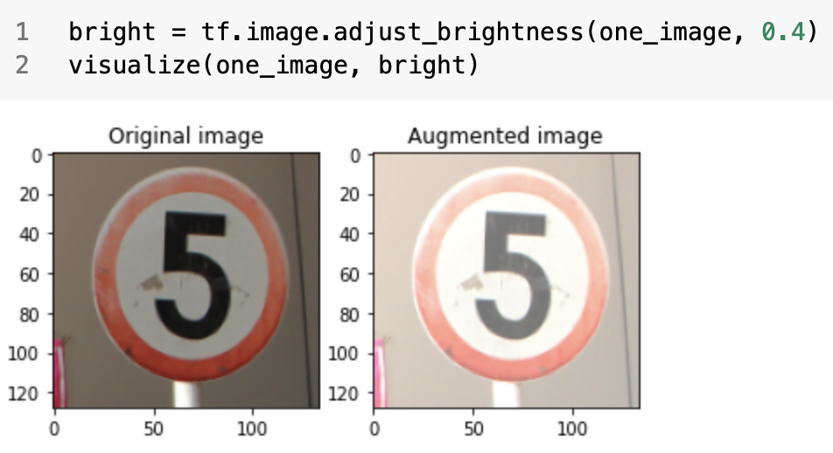
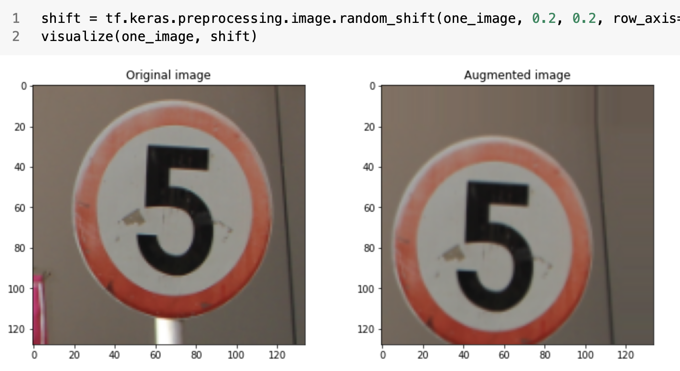
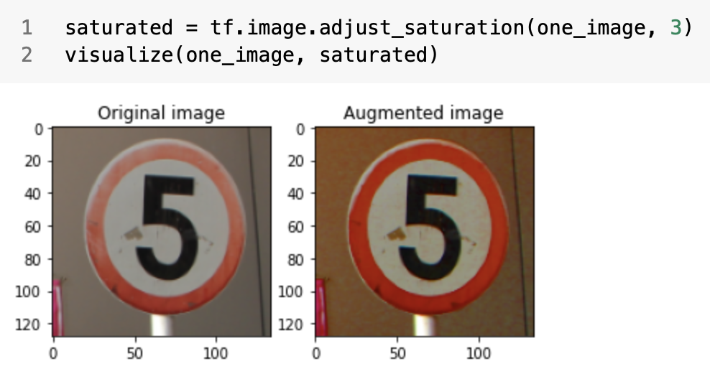
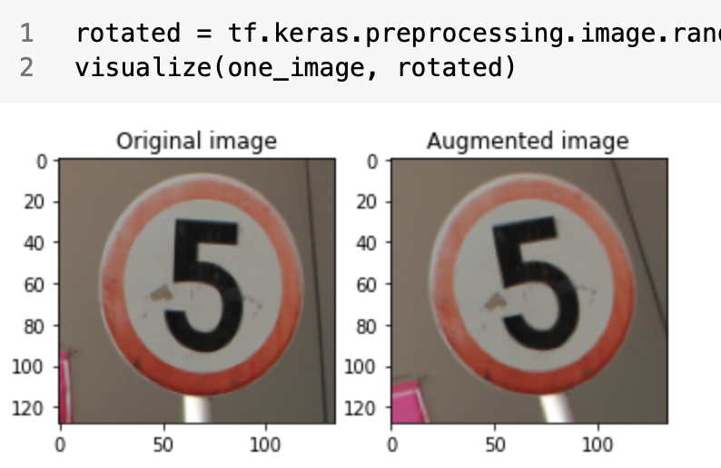
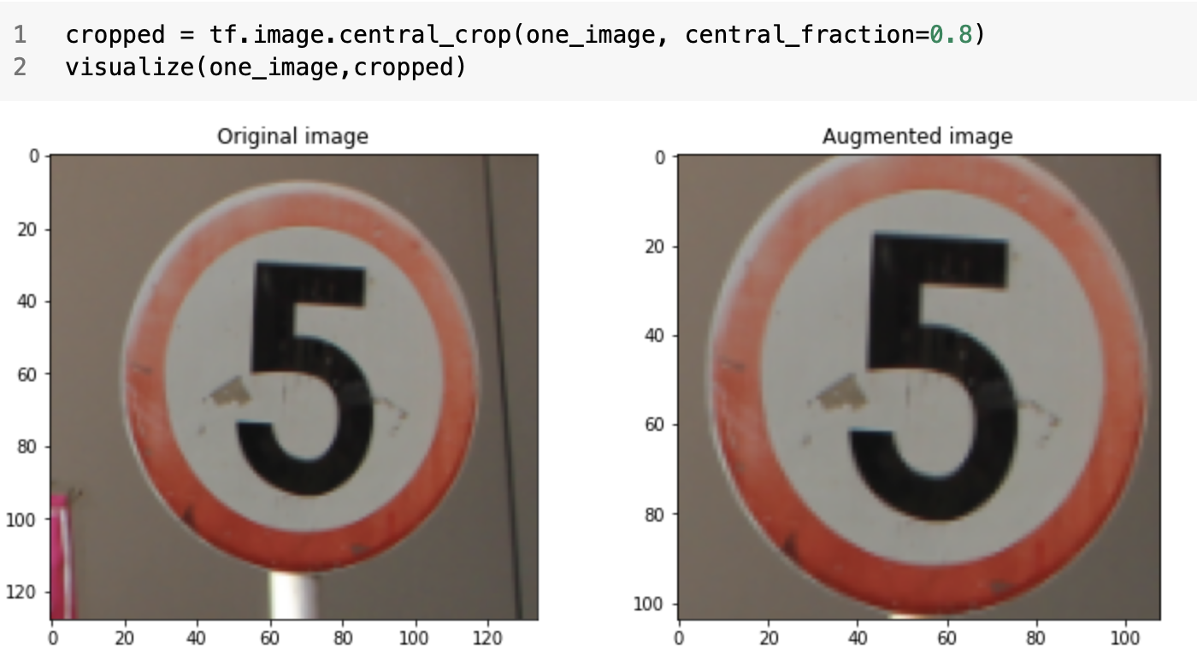
Data Augmentation

Slide 5
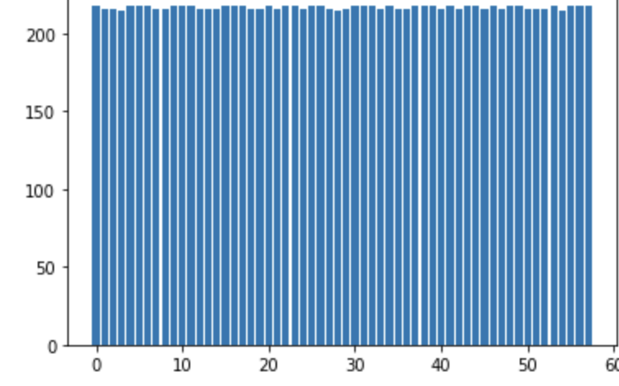
Data Augmentation
Original Dataset
4170
1994
12589
1051
943
24998
1051
943

Slide 6
Baseline
Naively predict all labels as category 54.
Accuracy: 108/943 = 11.45%

Slide 7
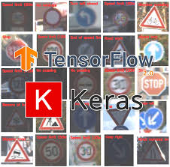
Methodology: Tensorflow & Keras
Dropout Regularization (25%/50%)
Early Stopping Regularization (25-30 epoches)
Data Augmentation (None, 12000+, 24000+)
Cross-Entropy Loss Function (categorial)
Mini-Batch Gradient Descent (batch size:256)
ADAM Optimization
ReLu Activation Function
Different Network Architecture
Transfer learning (ResNet50 & VGG16)

Slide 8
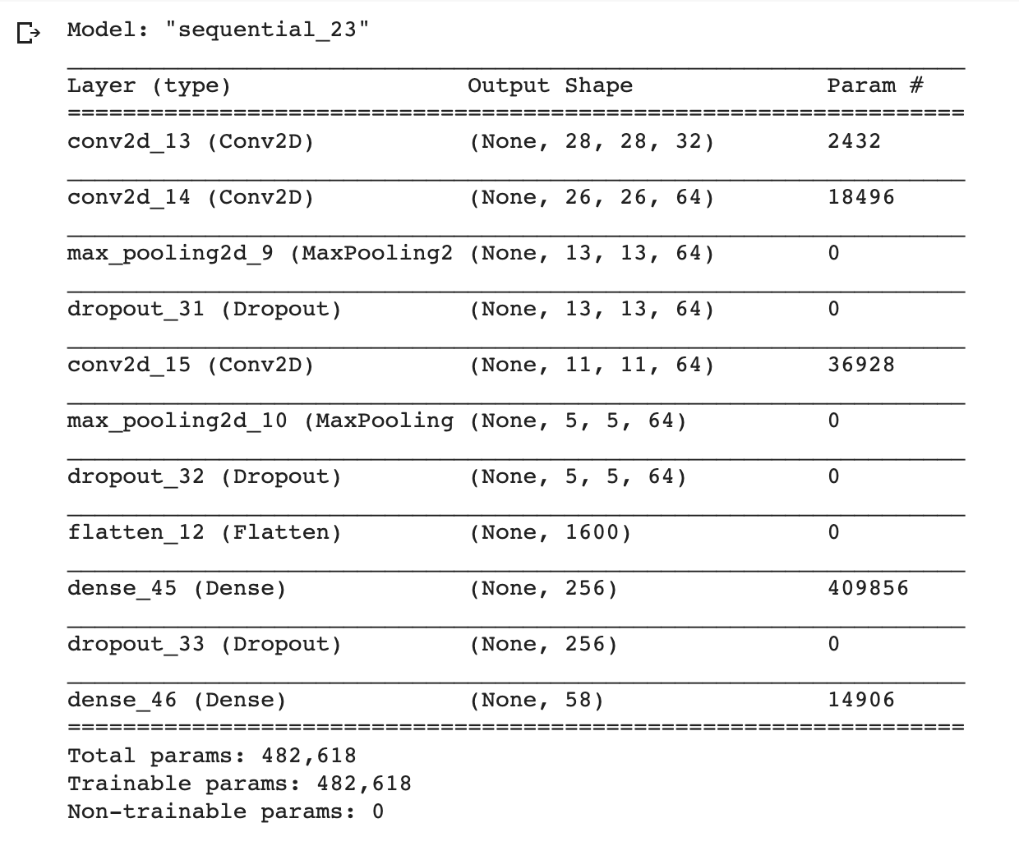
First Self-designed CNN architecture
3 convolutional layers
2 max pooling layers
3 dropout layers (25%)
2 fully connected (dense) layers

Slide 9
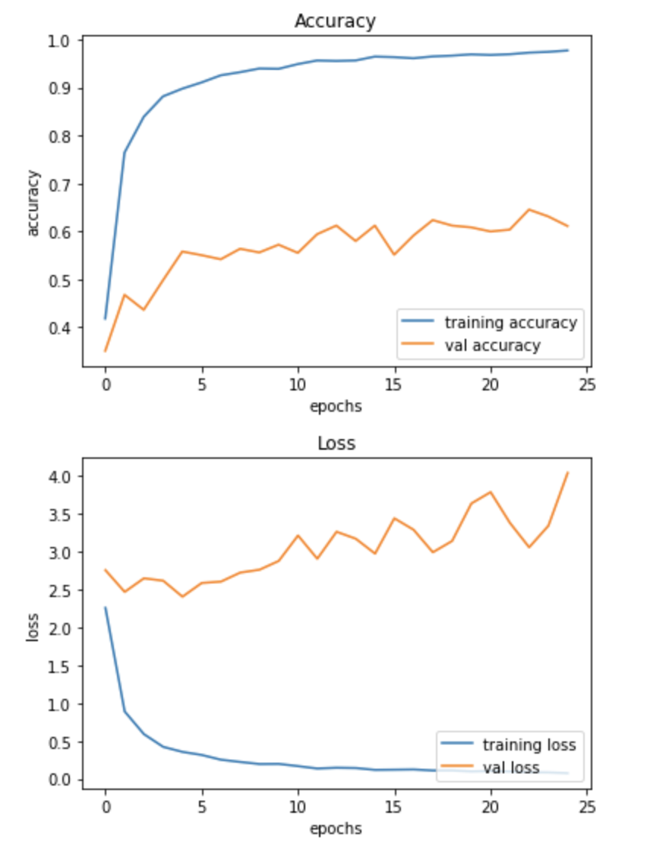
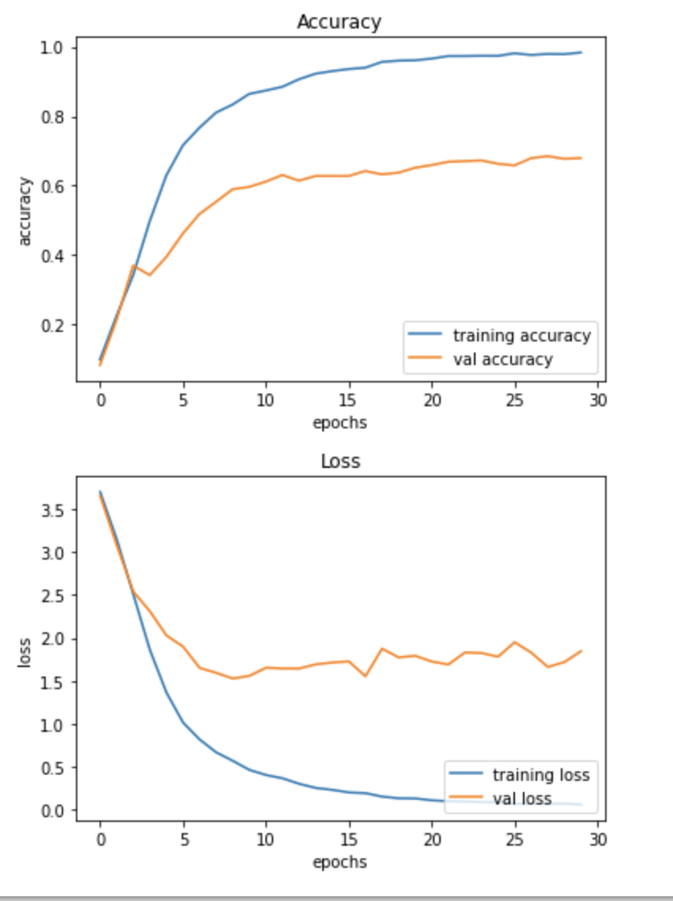
Result
With Data Augmentation:
12589 training set
After 25 Epoches:
Train Accuracy:0.9774
Validation Accuracy: 0.6108
Without Data Augmentation:
4170 training set
After 30 Epoches:
Train Accuracy:0.9835
Validation Accuracy: 0.6794

Slide 10
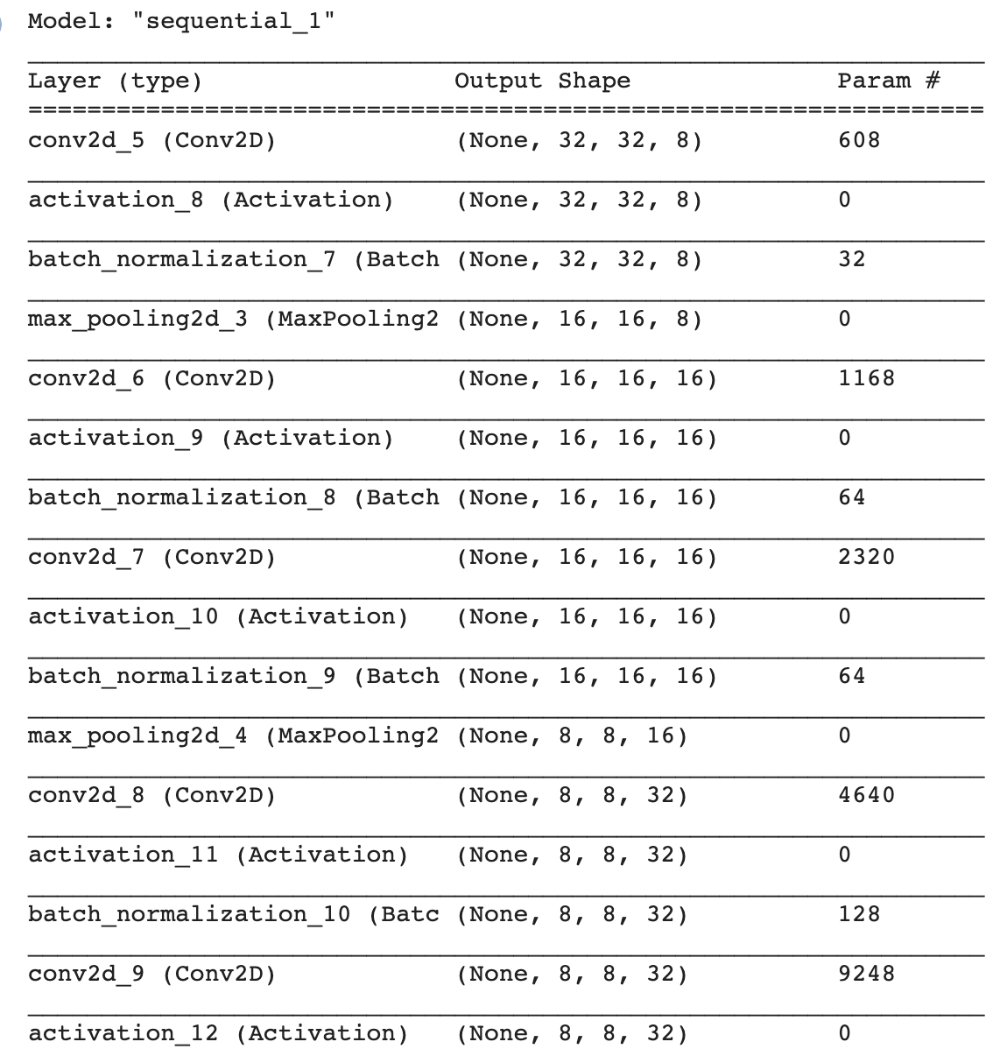
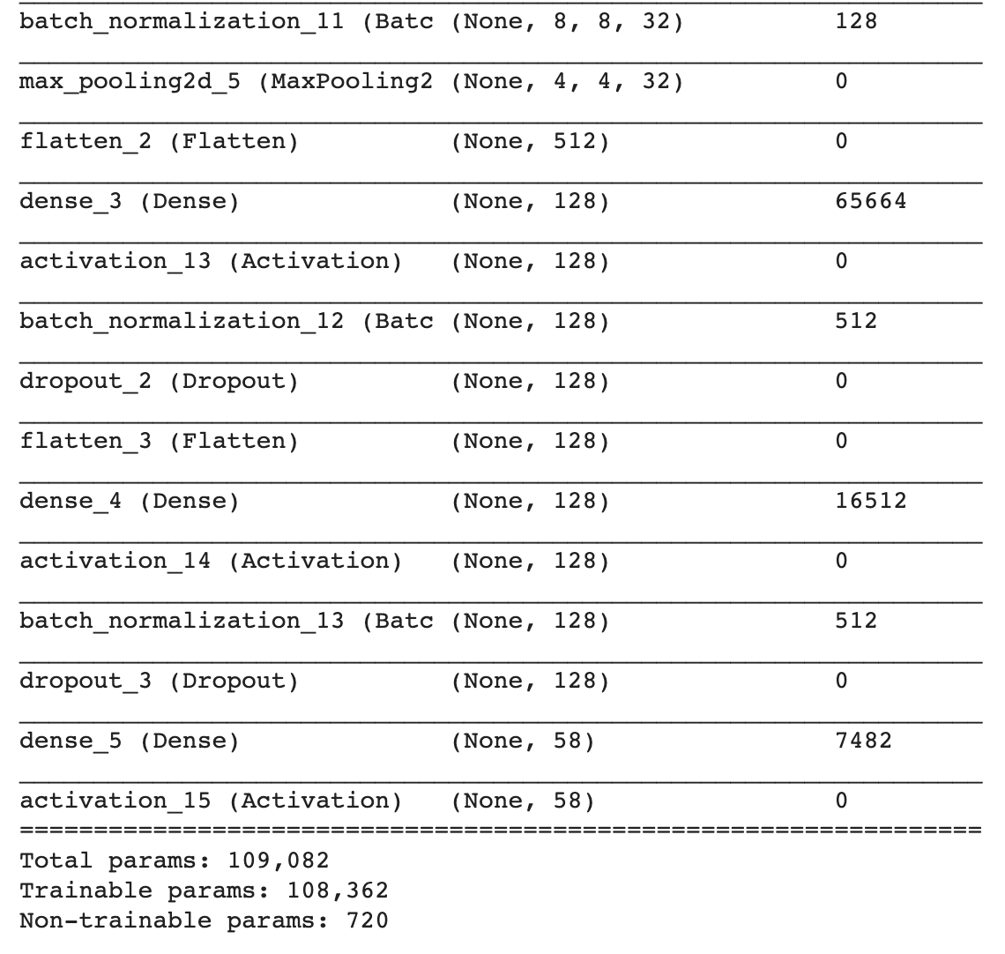
Second Self Designed Architecture with more layers
5 convolutional layers
3 max pooling layers
2 dropout layers
3 fully connected (dense) layers
7 batch normalization layers

Slide 11
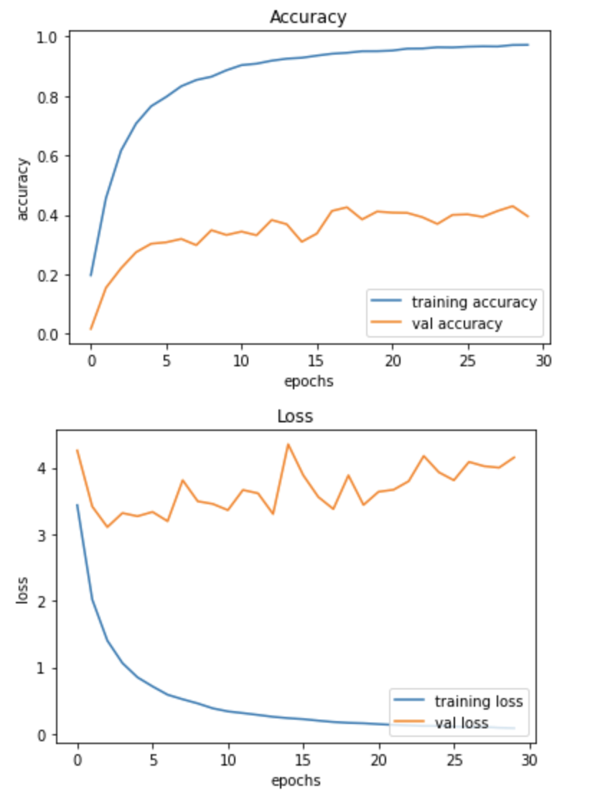
Result: Network with fewer layers works better
With Data Augmentation:
12589 training set
After 30 Epoches:
Train Accuracy:0.9718
Validation Accuracy: 0.3949

Slide 12
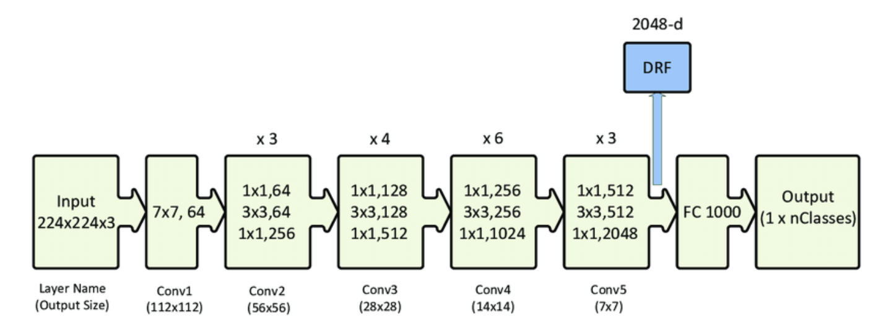
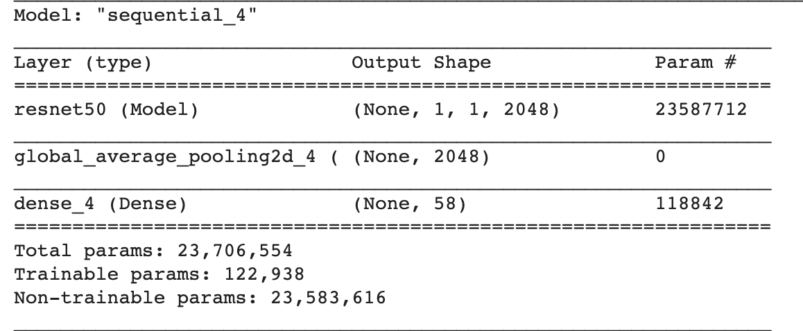
Transfer Learning: ResNet 50
Pretrained on ImageNet
http://ethereon.github.io/netscope/#/gist/db945b393d40bfa26006
Unfreeze the last two layers of ResNet 50

Slide 13
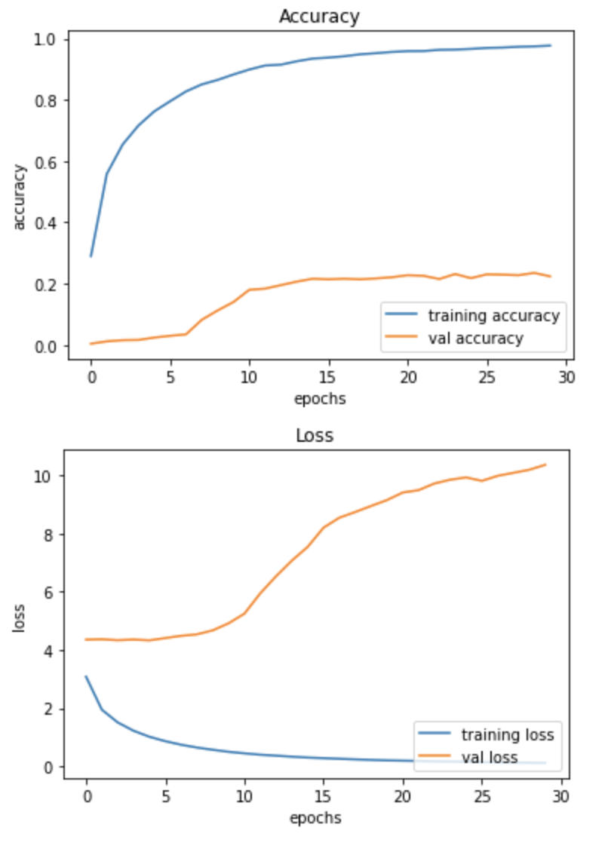
Result
With Data Augmentation:
12589 training set
After 30 Epoches:
Train Accuracy:0.9773
Validation Accuracy: 0.2236

Slide 14
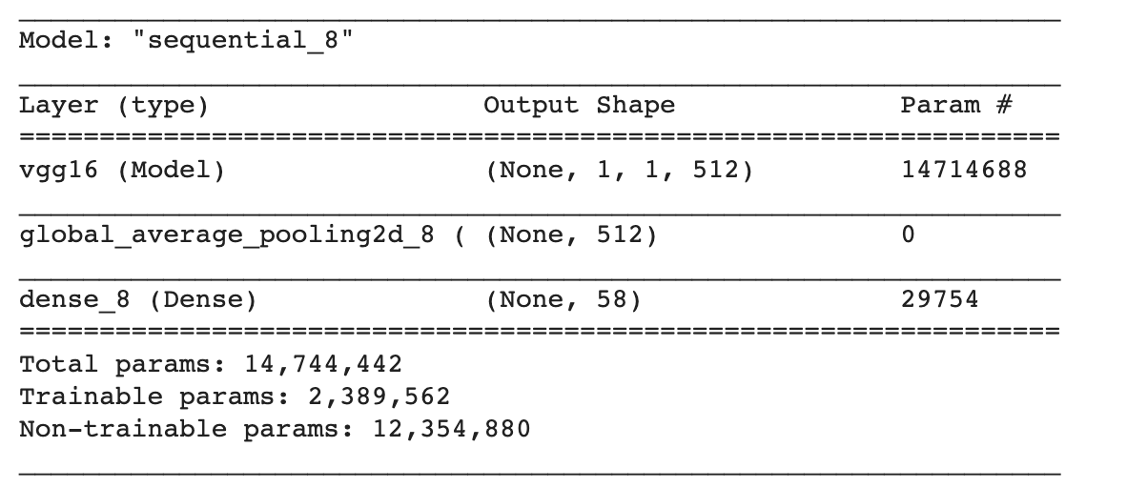
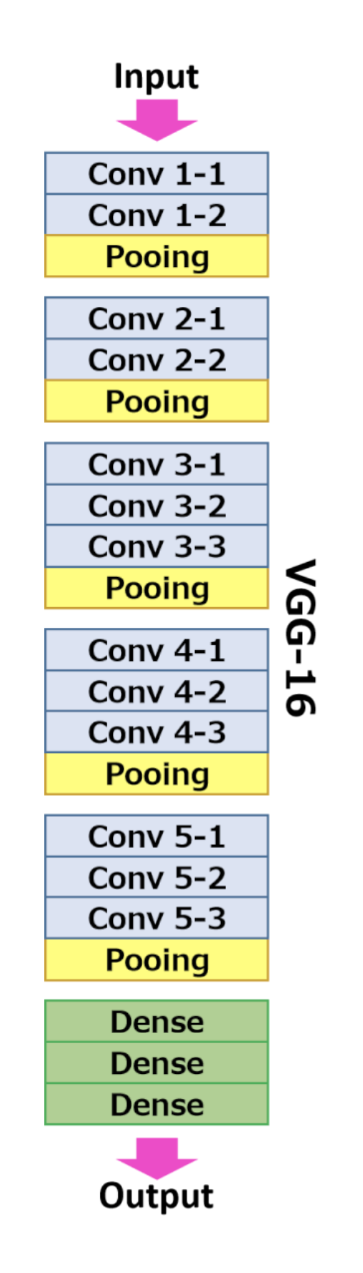
Transfer Learning: VGG 16
Pretrained on ImageNet
Unfreeze the last two layers of VGG 16

Slide 15
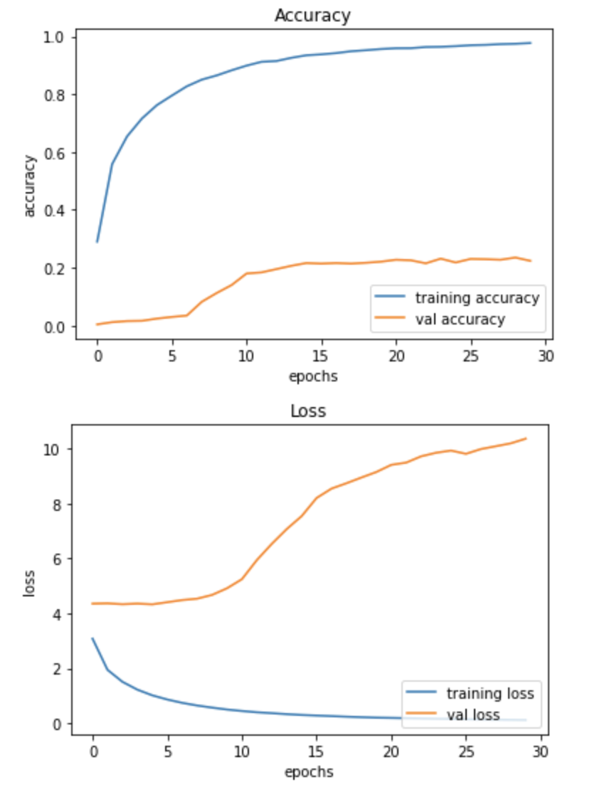
Result: VGG16 works better than ResNet50
With Data Augmentation:
12589 training set
After 30 Epoches:
Train Accuracy:0.9996
Validation Accuracy: 0.3834

Slide 16
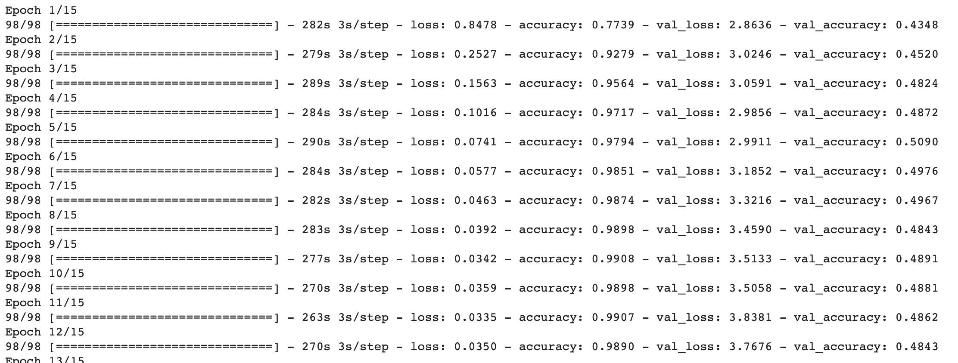
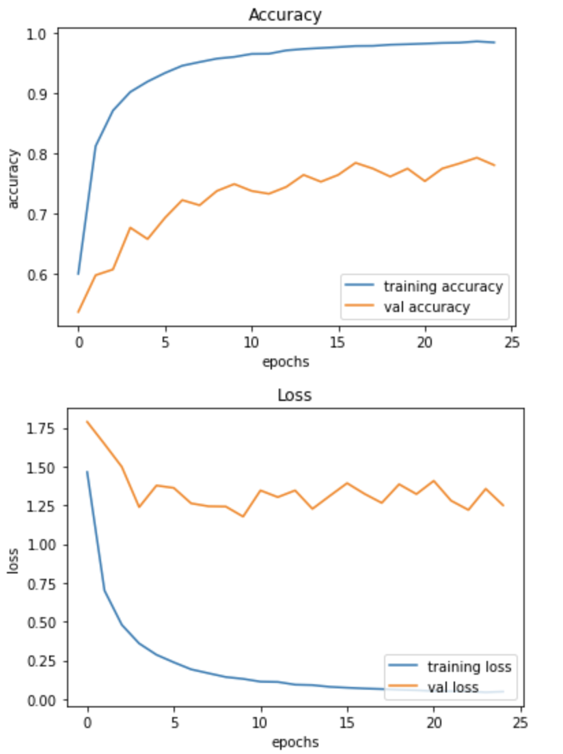
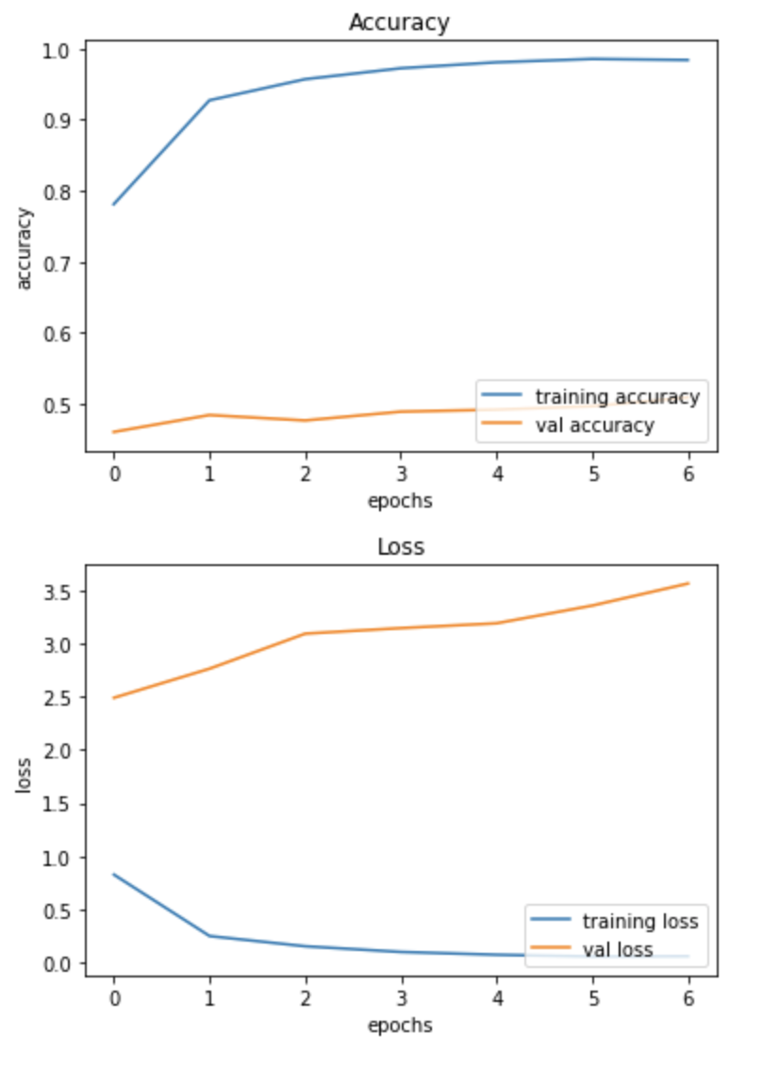
Apply First self-designed model and VGG 16 to the 24000+ data set
First Self-Designed Model:
VGG 16:
With Data Augmentation:
24998 training set
After 7 Epoches:
Train Accuracy: 0.9840
Validation Accuracy: 0.5090
With Data Augmentation:
24998 training set
After 25 Epoches:
Train Accuracy: 0.9848
Validation Accuracy:0.7812

Slide 17
Model Comparison (validation accuracy)
 | Non-Data Augmentation | 12589 | 24998
First Self-Designed | 67.94% | 61.08% | 78.12%
Second Self-Designed |  | 39.49%
Resnet 50 |  | 22.36%
VGG 16 |  | 38.34% | 50.90%

Slide 18
82.3%
Model applied to test set: First Model trained on training set with 24998 images

Slide 19
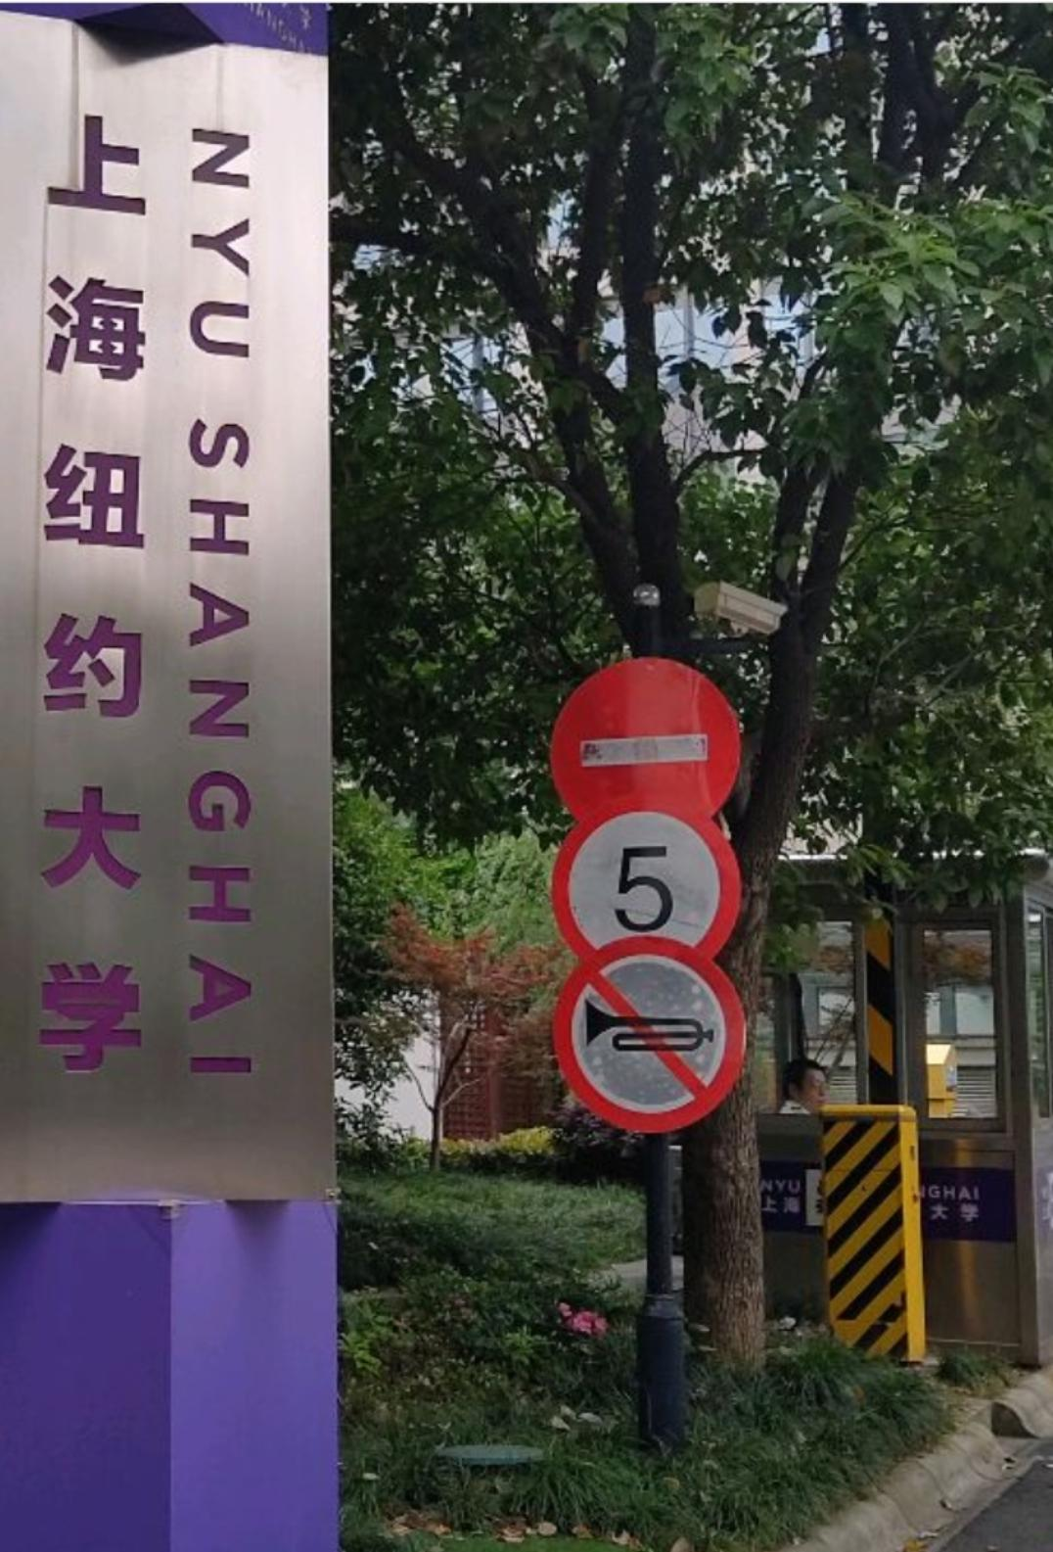
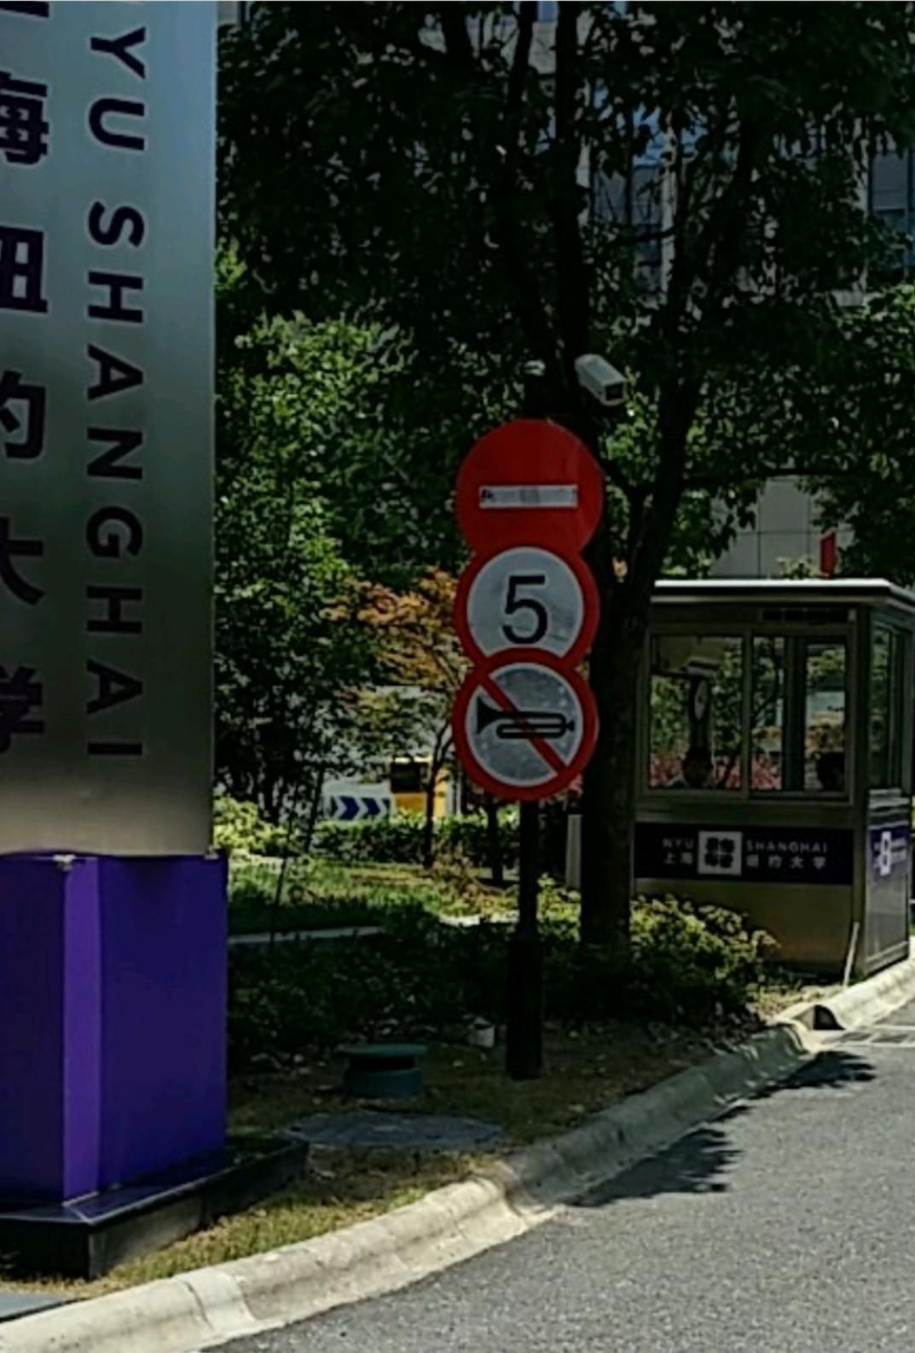
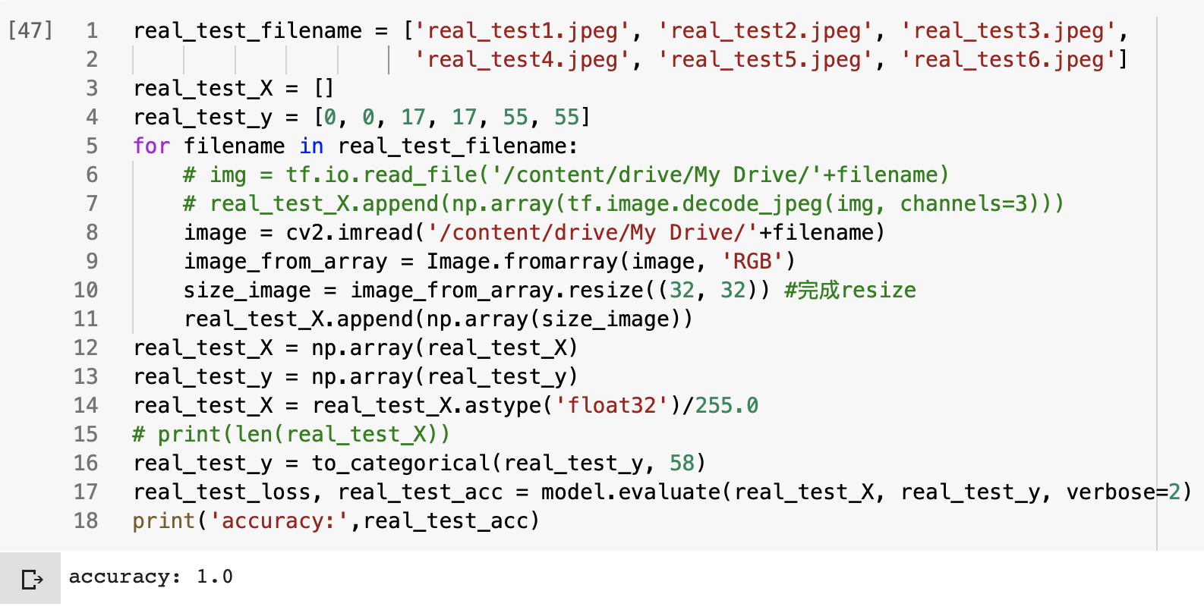
Testing with NYU Shanghai Data
100% accurate!

Slide 20
What we have learnt and What to improve
What we have learnt:
Build CNN based on tensorflow.keras
Transfer learning based on keras.applications
Choose a proper model
Data augmentation
NEW Dropout regularization
What to improve:
More various and larger data set to reduce variance
Combined with object detection to do further application
AUC (accuracy can be deceiving sometimes)

Slide 21

Thank you!

